Slide 1


CPSC 481 -
Team 34: StudyBuddy Tinder
Stage Four PPT
Brought to you by:
Chris C.
Thaddeus C.
Jaskaran S.
Junhyeok K.
Hassan I.

Slide 2

What will we be covering in today’s presentation?
Introduction
Demo of our prototype
Heuristic feedback from group
Heuristic evaluation report
Heuristic Analysis of Group 3.5

Slide 3
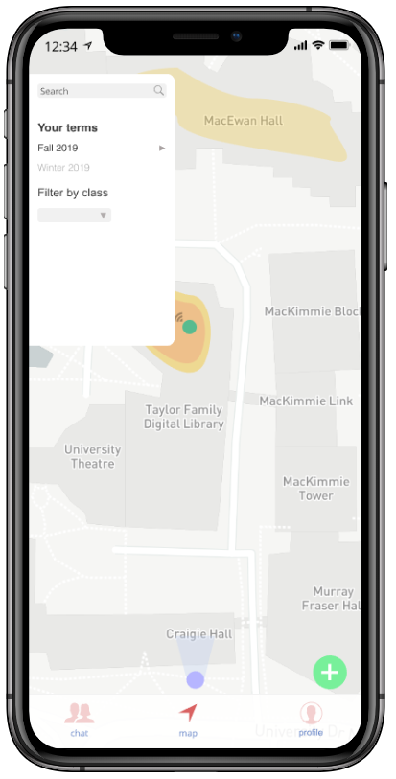

Introduction - Welcome back! Who are we again?
We are the folks that did the StudyBuddy Tinder app and we are here to show you our Hi-Fi prototype today! :)

Slide 4

Demo of our Prototype
First Iteration: https://sbuddies.invisionapp.com/prototype/ck3e1bgrl00dgik0125wgfh5x/play
Final Iteration: https://sbuddies.invisionapp.com/prototype/ck3dyd3xy00inkx01as2gyqts/play

Slide 5

Heuristic Evaluations from Group 3.5

Slide 6

Some the issues uncovered during evaluation
Search for new friends and send friend requests to them.
Subsequently, implementation of unfriend or block user feature you’ve added would be nice.
In the notifications, it can be seen when a friend is broadcasting. It should also implement the ability to join the session from here. Best to have a link to the map and show where the review is being held, as well as the info.
Would be interesting to see features such as event invitations, and event reminders.
If no parameters are entered, should fail to create an event and notify user.
Adding a class is only possible under the “add semester” button. Should implement a separate “add class” button.
Saving for Stage 5
It would be nice to have the name at the top of the chat so it is more clear who you are speaking to.

Slide 7

Some the issues uncovered during evaluation
In profile tab, semesters are categorized only by winter and fall, and not year.
No option to delete, edit messages or profile information
User can add incorrect events
Chat icon is very similar to the friend icon in other apps, even though it leads to the friends list.
Implementation of an additional screen to confirm the user is sure to create/join an even near the middle of the screen would allow for better error prevention.
Shifting the sidebars down would allow for better error prevention. As it currently is, a user may accidentally click volume increase/decrease.
Add help and documentation to explain what can be tapped/used, No in app support.
Have to click accept twice to accept friend. Change second one to “Accepted as a Friend!”

Slide 8

Personal Heuristic Evaluation

Slide 9
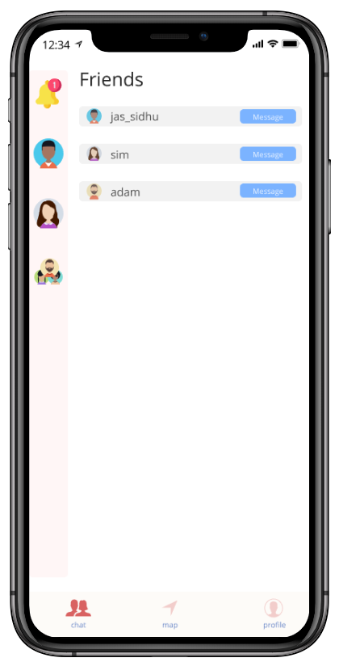
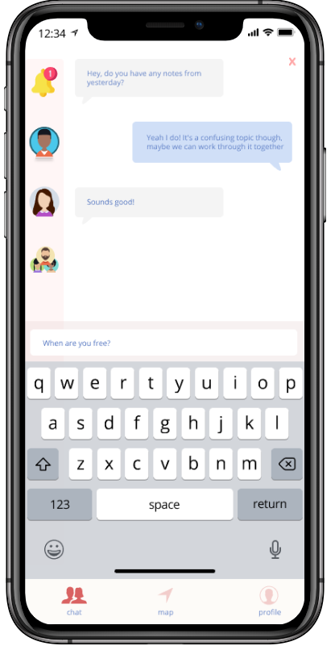
Some of the issues we uncovered:
The “Chat” icon is very similar to the friends icon used in many other apps.
It would better represent a match to the real world to change the icon to a more conventional “Chat” icon. We plan on changing this to create a better match between our system and the real world, thus minimizing user confusion.
The ability to search and find friends on the app.
This is a social app after all.
In the notifications, it can be seen when a friend is broadcasting an event.
The ability to join the session from that notification would very useful and would allow for higher efficiency when navigating through the app.
We also believe it would be useful for this to be on the map page, as it would allow the user to efficiently see where the event is.

Slide 10

Continuation. . .
Through the evaluation, it was also brought to our attention that a user cannot view or edit the event they have created.
To fix this, we have implemented an edit button for the event they have created. The button will be similar to the add new event button, however it will be there to edit their current event.
It has been suggested that the ability to invite friends to join an event would be a good feature.
However, we have already implemented this, it seems it has been overlooked. When creating an event, you can invite friends. This can be seen by following the path Map → Plus symbol (bottom right of page) → Invite friends.
We are also adding the name at the top of the chat to make it more clear who you are speaking to.
The app seemed to be “boring” because of the lack of color.
It seemed simple, clean, but also very plain. For this reason we have decided to add some color into the profile tab!

Slide 11
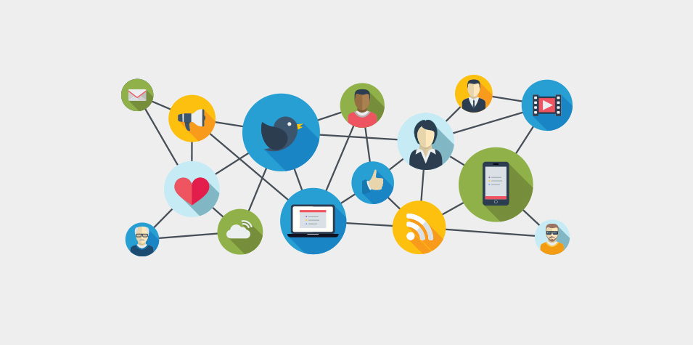
Heuristic Evaluation of Group 35
The app we covered here was for U of C Mingle, a social app to connect students to the various clubs at the U of C.

Slide 12
Visibility of System Status:
Overall the App does a good job of letting the user know information about upcoming events specifically keeping the recent announcements front and center is good in the sense that it allows the app to be as user centric as possible.
Match between system and the real world
Given it is a location specific application (u of c). we can assume the users (students) will have a clear understanding of locations mentioned on the map as well as the searchable events. Furthermore, there is a map to show this through a more visual way.
User Control & Freedom
The bottom navigation bar makes it easy to move around the app as well as back out of things. One possible gripe would be when the user is in the search flow, then selects France, and adds the event to the schedule, this then takes the user to the location on the map.
4. Consistency & Standards
Very University student infused linguistics here. The primary demographic of students will easily be able to understand everything that is going on.
5. Error Prevention
No errors were found aside from issues with the flow mentioned in the above points, this there was no need to check for error messages.
6. Recognition rather than recall
Objects & actions are visible (details about events, flags in the map section pertaining to upcoming events). App does not necessarily need the user to recall information from another flow they may have been on.

Slide 13
7. Flexibility and Efficiency of Use
System seems quite rigid and there is no way to naturally flow from one section to another without tabbing out using the bottom navigation bar. This makes it difficult for a expert user to be any faster than a novice user.
8. Aesthetic and Minimalist Design
As mentioned above the announcement section does well in hiding unnecessary information. Could go further and have the recent announcements as an additional smaller section to something major as opposed to it being the main feature itself?
9. Help users recognize, diagnose, and recover from errors
This was absent from the app with good reason, as there aren’t any severe errors in the app that would need a solution to be suggested.
10, Help & Documentation
The system does not seem confusion in a general sense. Although the app does not have help and documentation, it seems like it is not required as it is self-explanatory and even a new user can pick it up quickly

Slide 14

Any questions? If not, thank you for listening!

